Slide 1
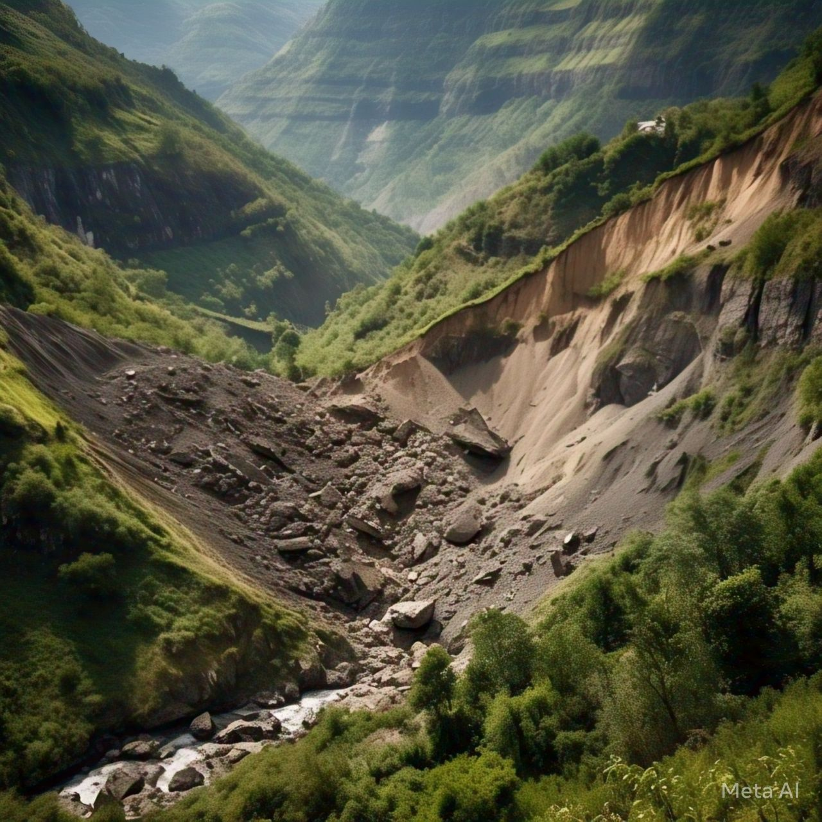
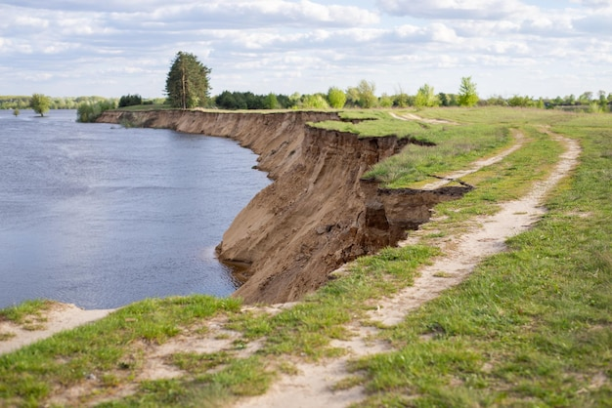
Preventing Landslides: A Comprehensive Approach
Our team's innovative landslide detection and prevention system helps protect communities. We use advanced technology and data analysis to predict and mitigate risks.
~ by TEAM YOJONA

Slide 2


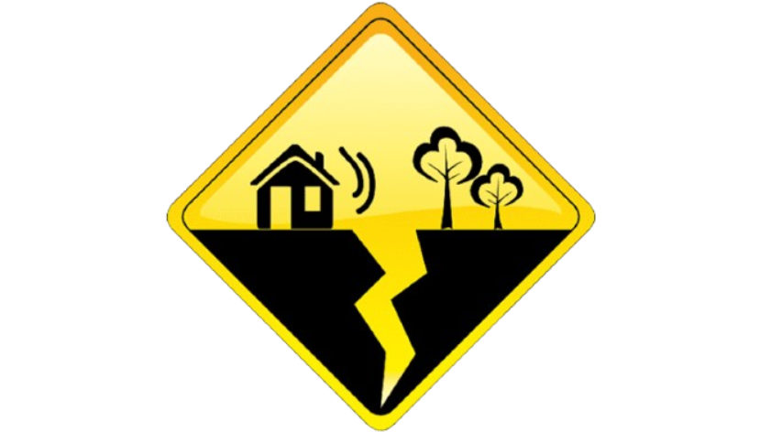



Landslide Triggers: 5 Key Factors
1
Rainfall Amount
2
Soil Moisture
3
Soil Texture
4
Earthquake Activity
5
Landscape Features
6
Past Landslide History

Slide 3

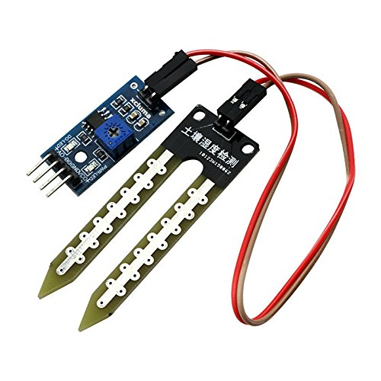


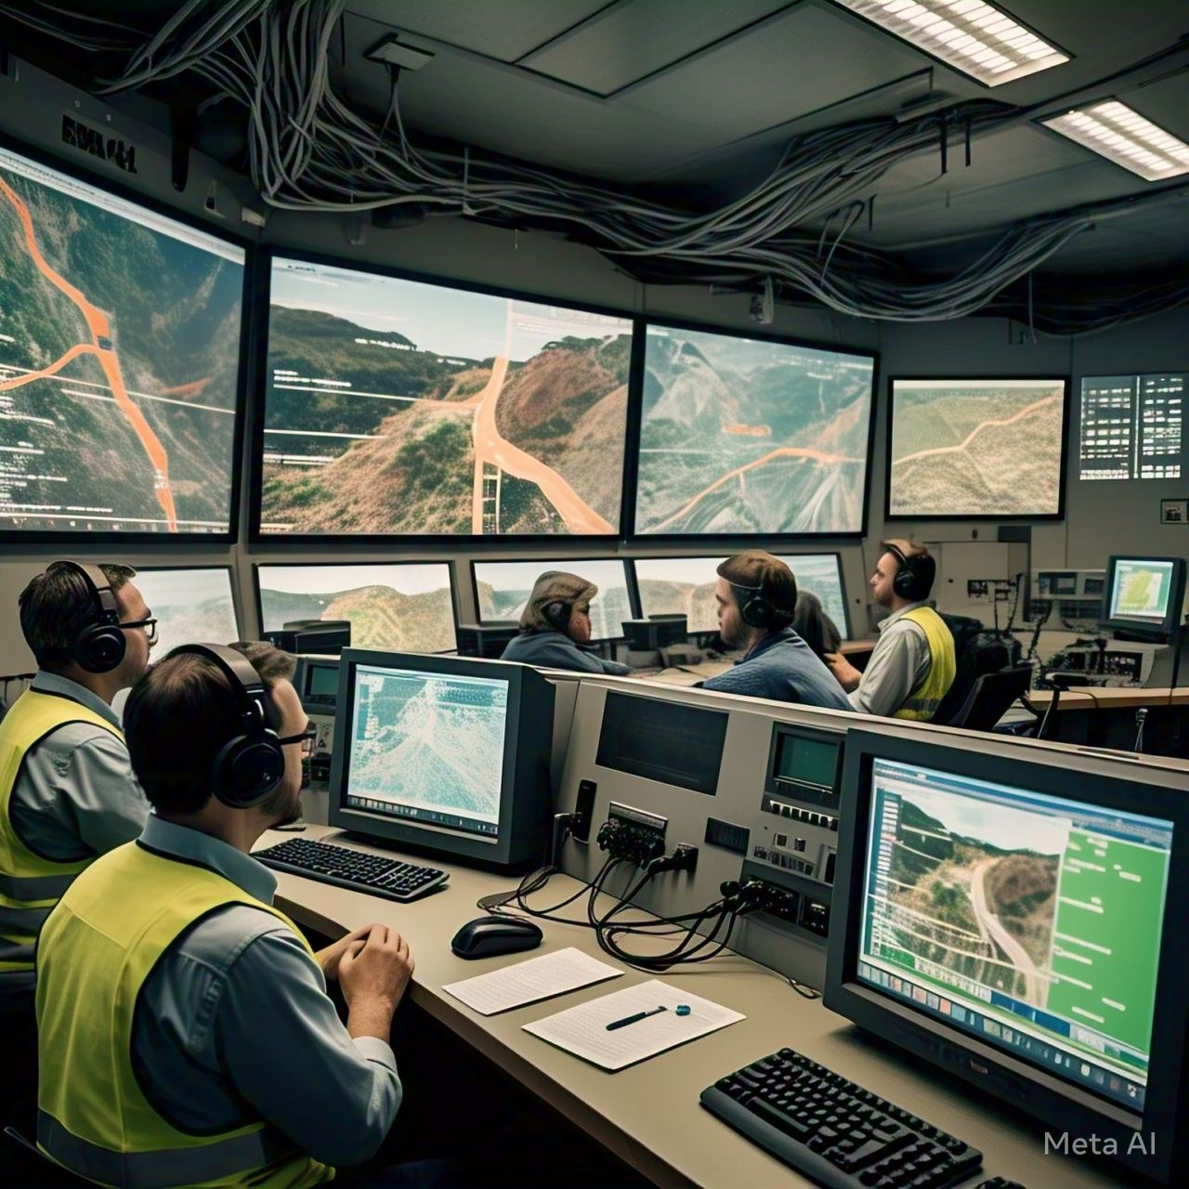
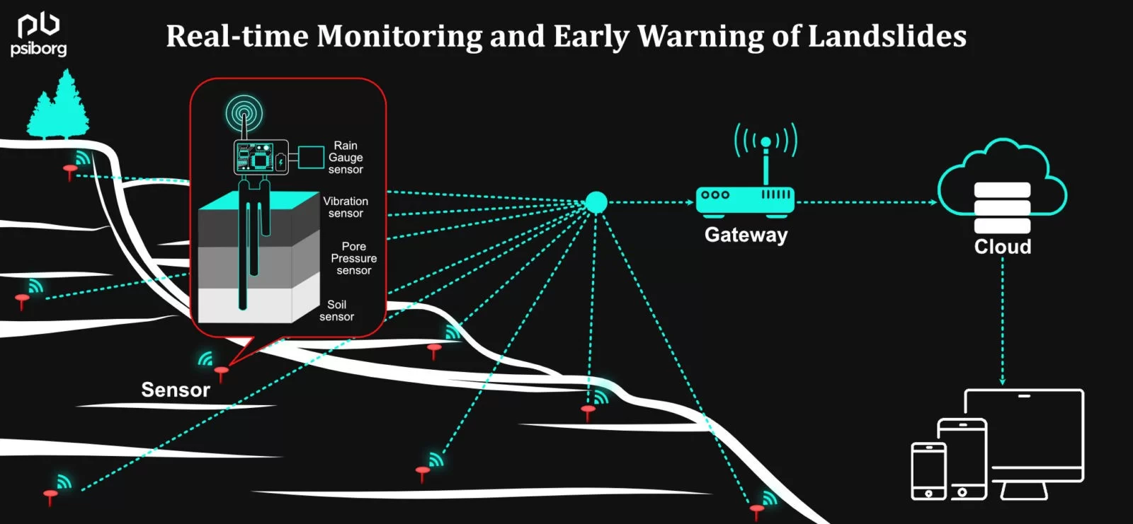
Monitoring for Early Warning
Rainfall Sensor
Soil Moisture Sensor
Soil Movement Sensor
Earthquake Sensor
Our system constantly monitors these factors using specialized sensors.

Slide 4








Predictive Analytics for Risk Assessment
Sensor Data
1
Data Analysis
Real-time information from sensors
2
Advanced algorithms process data
Warning System
4
Risk Assessment
3
Alerts authorities if risk is high
Predicts landslide probability

Slide 5
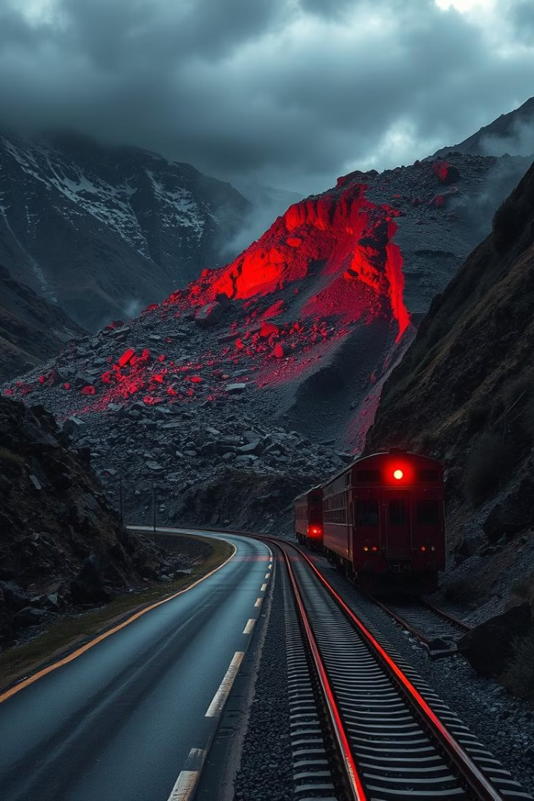
Proactive Response: Preventing Accidents
1
Risk Threshold
70% chance of landslide
2
Warning Issued
Alerts disaster management offices
3
Pre-Landslide Measures
Roads and rail lines closed
4
Post-Landslide Response
Automatic track blockage

Slide 6
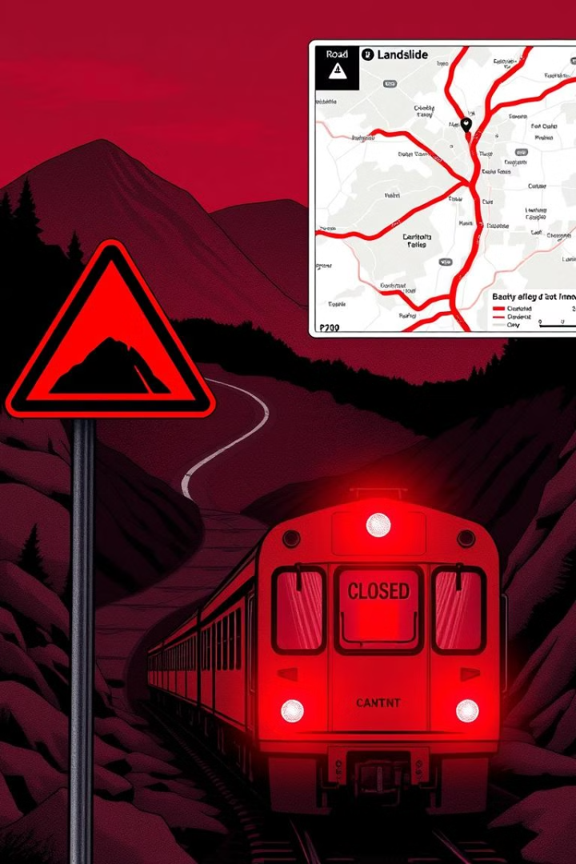



Pre-Landslide Mitigation: Road and Rail Safety
85-99% Risk
High chance of landslide
Road Closure
1 km range around risk area
Rail Line Closure
1 km range around risk area

Slide 7
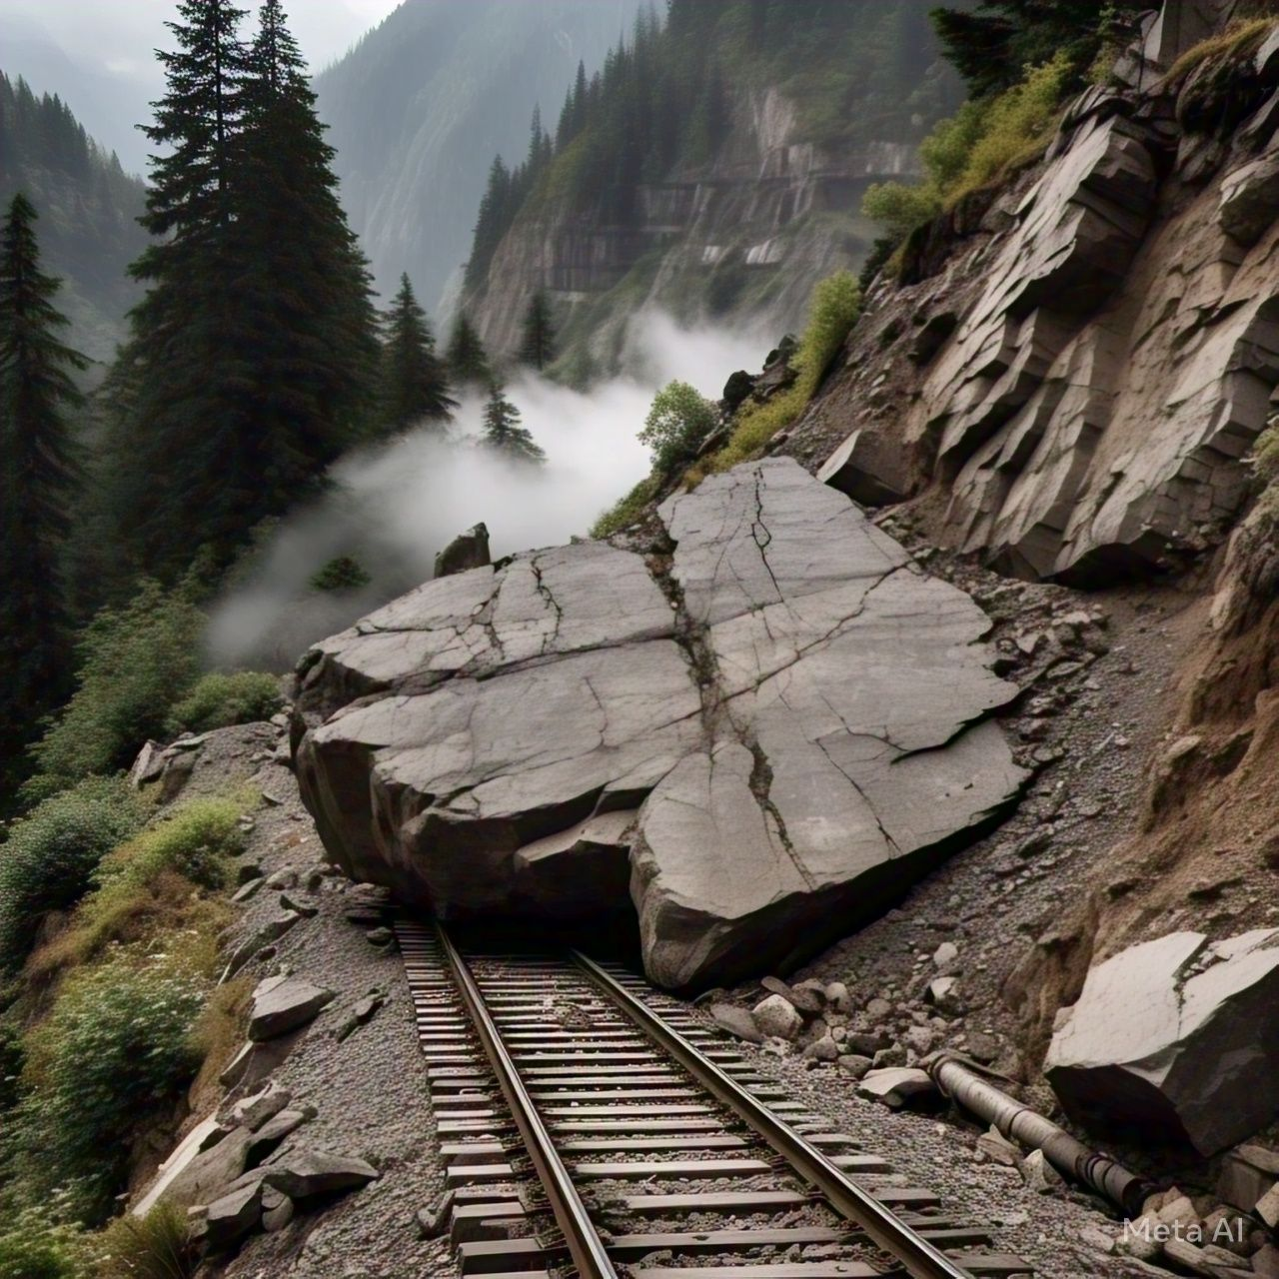

Post-Landslide Safety Measures: Automatic Track Protection
Landslide Detected
Track obstruction identified
Automatic Signal
Red signal activated for 1 km
Train Stops
Preventing accidents and collisions

Slide 8

Yojona: A Step Towards Safer Communities
Yojona provides an early warning system that helps protect lives and infrastructure. This project showcases the power of technology to address real-world challenges and build resilient communities.

